Slide 1


Edgar Elizondo
29-Apr-2024

Slide 2






Outline
Executive Summary
Introduction
Methodology
Results
Conclusion
Appendix

Slide 3

Executive Summary
The main objective of this presentation is to introduce the findings of the research conducted on SpaceX, aiming to determine the factors that contribute to the success of a launch. The following section will outline the process and methodologies employed.
Web Scraping
Data wrangling
Data Exploring
Data Analysis
Data visualization
Model prediction building
Due to the extension of these project, the results, analysis and observations are presented according the following areas.
Exploratory Data Analysis
Data Interactive Visualization
Prediction Models

Slide 4

Introduction
Background
Space X advertises Falcon 9 rocket launches on its website with a cost of 62 million dollars; other providers cost upward of 165 million dollars each, much of the savings is because Space X can reuse the first stage. Therefore, if we can determine if the first stage will land, we can determine the cost of a launch. This information can be used if an alternate company wants to bid against space X for a rocket launch. This goal of the project is to create a machine learning pipeline to predict if the first stage will land successfully.
Objectives
Find which factors determine a successful outcome.
Find the relationship between these factor.
Create a dashboard to visualize these correlations.
Build a model to predict the success or failure outcome.

Slide 5

Section 1

Slide 6

Methodology
Data collection:
The data collection was made by SpaceX API and Web Scraping tools.
Perform data wrangling
Task such filter data, fill missing data, one-hot-encoding were made.
Perform exploratory data analysis (EDA) using visualization and SQL.
Perform interactive visual analytics using Folium and Plotly Dash
Perform predictive analysis using classification models
The data was split in train set and test set, and then was analyzed by different model

Slide 7
Data Collection – API
Request data.
Employ requests.get() method to obtain the API information for the given URL.
Decode response.
Use json_normalize() method to convert the .json() result into a DataFrame.
Get Information.
Given the customize function the main launch information is selected.
Create DataFrame.
Construct the dataset using the data obtained by the customize function.
Filter DataFrame.
Remove the Falcon 1 launches keeping only the Falcon 9 launches.
Wrangle DataFrame.
Replace the PayLoad missing values with its mean() value.
Export Data.
Create the .csv file.
https://github.com/EdgarElizondo/SpaceX_LandingPrediction/blob/main/01_Data_Collection_API.ipynb

Slide 8
Data Collection – Web Scraping
Request data.
Employ requests.get() method to obtain the API information for the given URL.
Create BeautifulSoup Object.
Use BeautifulSoup() to create a BeautifulSoup object from a response text content.
Extract Column Names.
Use the find_all function in the BeautifulSoup in combination with the extract_column_from_header() method to get a column name.
Create DataFrame.
Construct the dataset by parsing the launch HTML tables.
Export Data.
Create the .csv file.
https://github.com/EdgarElizondo/SpaceX_LandingPrediction/blob/main/02_Data_Collection_WebScraping.ipynb

Slide 9
Data Wrangling
Load and Explore Data.
Explore the data to determine the training labels.
Calculate.
The no. launches on each site.
The no. occurrence of each orbit.
The no. and occurrence of mission outcome of the orbits.
Create Outcome Labels.
Label each landing as Successful or Unsuccessful according with the EDA.
Export Data.
Create the .csv file.
https://github.com/EdgarElizondo/SpaceX_LandingPrediction/blob/main/03_Data_Wrangling.ipynb

Slide 10
EDA with Data Visualization
Scatter Plot.
Bar Plot.
To analyzes a specific attribute of a parameter
Successful landing rate per Orbit
Line Plot.
To visualizes a parameter trend over time
Successful landings per Year
Export Data.
Create the .csv file.
To visualize the relationship between parameters:
Flight Number vs Pay Load
Flight Number vs Launch Site
Flight Number vs Orbit
Pay Load vs Launch Site
Pay Load Mass vs Orbit
https://github.com/EdgarElizondo/SpaceX_LandingPrediction/blob/main/05_EDA_Data_Visualization.ipynb

Slide 11

EDA with SQL
Queries.
Display the names of the unique launch sites in the space mission
Display the total payload mass carried by boosters launched by NASA (CRS)
Display average payload mass carried by booster version F9 v1.1
First successful landing outcome in ground pad achieved
Total number of successful and failure mission outcomes
Booster versions which have carried the maximum payload mass
Rank the count of landing outcomes
SQL Queries.
Different SQL queries were applied to get insight the data.
https://github.com/EdgarElizondo/SpaceX_LandingPrediction/blob/main/04_EDA_Data_SQL.ipynb

Slide 12
Build an Interactive Map with Folium
Create a Map
Use Folium to create map to locate the launches sites
Marked launches sites
That indicates the coordinate of each launch.
Identify launch outcome
Use code color to indicate the success or failure of each lauch
Calculate distances
To their main proximities (coastlines, railways, highways, cities)
https://github.com/EdgarElizondo/SpaceX_LandingPrediction/blob/main/05_EDA_Data_Visualization.ipynb

Slide 13
Build a Dashboard with Plotly Dash
Create a Dashboard
An interactive dashboard is built with Plotly dash.
Add Decisions Makers
The launch site and the payloads mass are chosen as decisions makers by adding a dropdown menu and a slider bar.
Pie Graph
To visualize the successful landing rate per launch site.
Scatter Plot
To visualize the successful landing rate according to payload mass.

Slide 14
Predictive Analysis (Classification)
Load Data.
Load the DataSet into a DataFrame object
Processing Data
The data goes through a Standard Scalar processing
Split Data.
Split the data between train and test set
Create Grid Search Object.
The Grid Search Object helps to analyzes several configuration from the same prediction model and choose the best.
Models.
- Logistic Regression
- Support Vector Machine
- Decision Tree
- K-Nearest Neighbors
https://github.com/EdgarElizondo/SpaceX_LandingPrediction/blob/main/08_Machine%20Learning%20Prediction.ipynb

Slide 15

Section 2

Slide 16
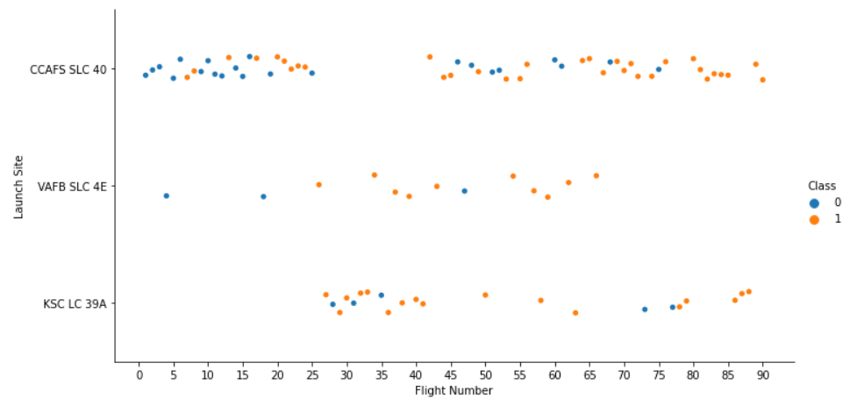
Flight Number vs. Launch Site
Although initially the percentage of successful landings is low, this increases as the number of flights rises.
Most launches occur at CCAFS SLC 40, which could be interpreted as the most reliable or accessible launch site for SpaceX.
Starting from flight 35, the percentage of successful flights among the three launch sites is similar.
Unsuccessful
Successful

Slide 17
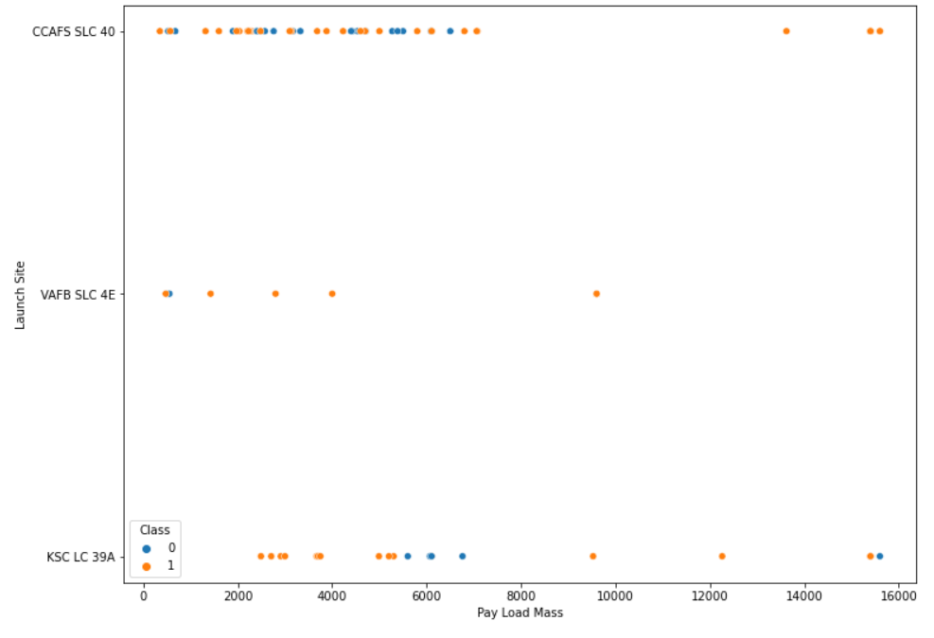
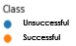
Payload vs. Launch Site
Most of the launches have payloads below 8000 kg.
Payload Mass over 8000 kg have a better successful landing rate.
CCAFS SLC-40 is the launch site with more launches. Although is used for launches over 8000kg payload mass, has more flights below this payload.
VAFB SLC 4E has of payloads lower than 5000 kg most of the time.
KSC LC 39A performs well over 8000kg payload. Besides, is the Launch site with more flights over this payload.

Slide 18
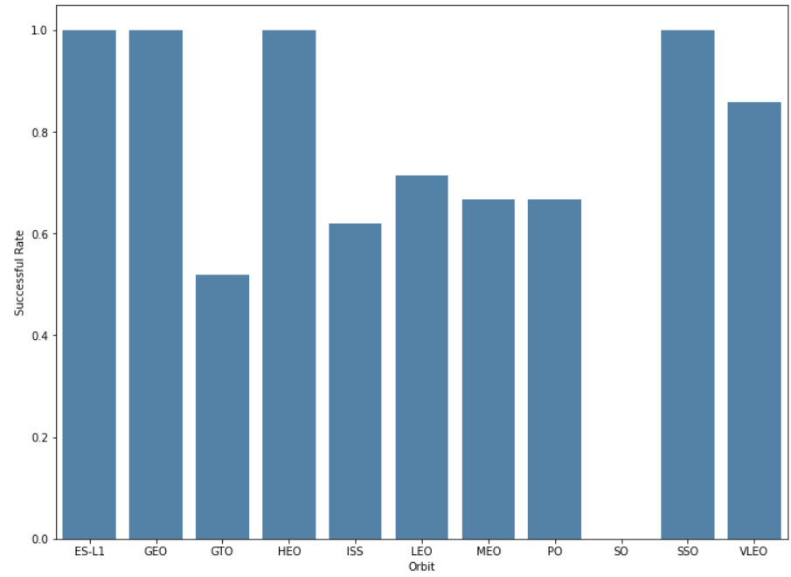
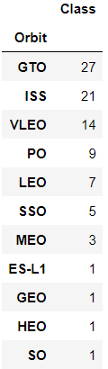
Success Rate vs. Orbit Type
The orbit ES-L1, GEO, HEO and SSO have a 100% successful landing rate. However, for these orbits just SSO has more that one landing.
VLEO has the second one best successful landing rate, above 80%, and is the third one with more landings. Hence, is can being considered as a valid option.
GTO and ISS are the orbits with more landings. However, they just have around 50-60% of successful landing rate.
The Orbit SO has 0% successful landing rate. However, this orbit has just one landing. Hence, is early to discard it as an option.

Slide 19
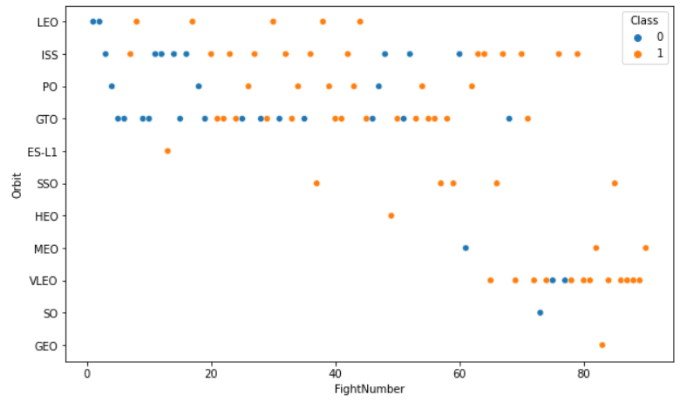
Flight Number vs. Orbit Type
Although initially the percentage of successful landings is low, this increases as the number of flights rises.
GTO and ISS are good examples on how the successful landing rate has increased.
VLEO has been used as Launch Site in recent flights.

Slide 20
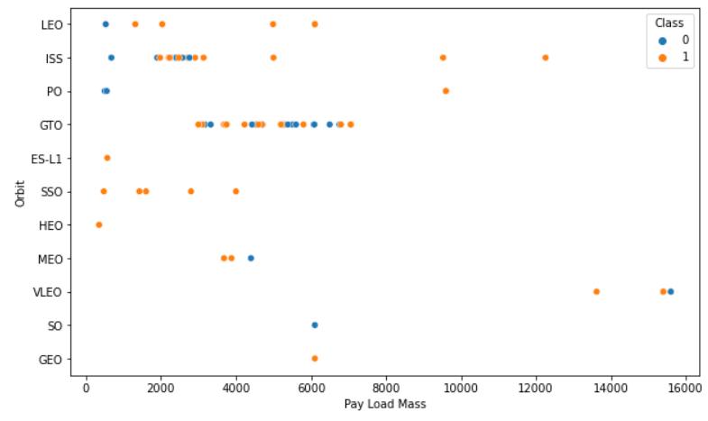
Payload vs. Orbit Type
GTO and ISS are used for a specific payload mass range.
ISS, PO and VLEO are the only orbits with payloads over 8000kg.
SSO, one of the best launching orbits, is below 5000kg payload mass.
VLEO, one of the best launching orbits, is above 13000kg payload mass.

Slide 21
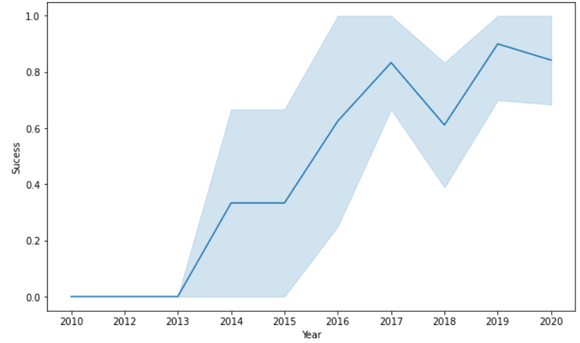
Launch Success Yearly Trend
The graphs shows how the successful landing rate has increase over the time.
Since 2013 the successful landing rate has improved considerable.
Since 2017 the variance in the landing rate has decreased.

Slide 22
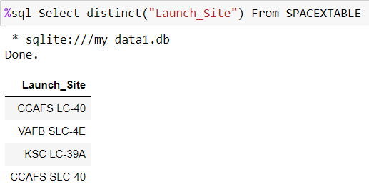
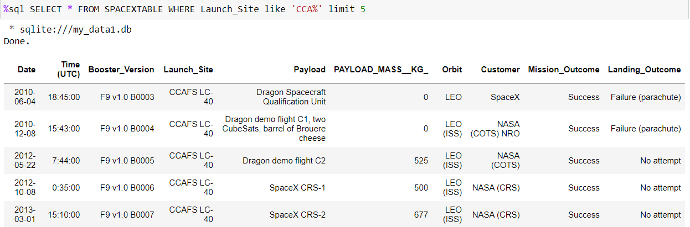
Launch Site Information
Names of the Launch Sites
First 5 records where launch sites begin with the string 'CCA’.

Slide 23
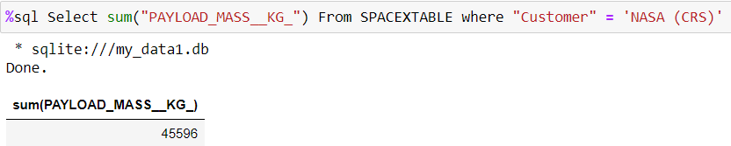
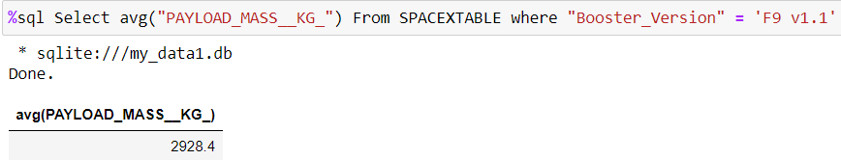
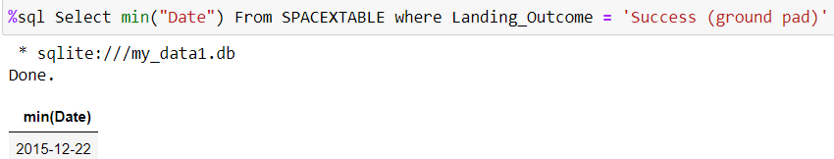
Payload Mass & First Successful Land
Total Payload Mass carried by Nasa (CSR)
Average Payload Mass where F9 v1.1 was the booster version
First Successful landing on ground pad

Slide 24
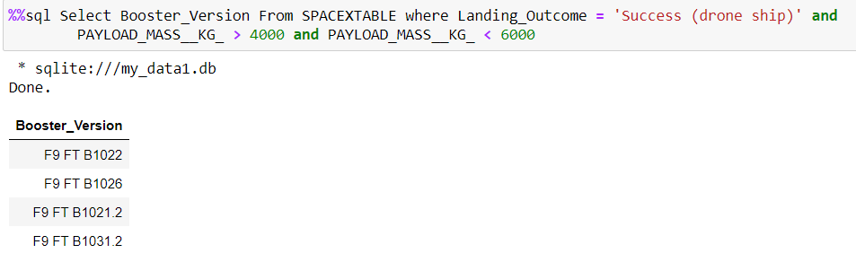
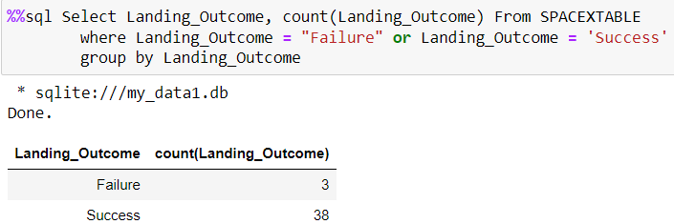
Successful Drone Ship Landing with Payload between 4000 and 6000
List the names of the boosters which have success in drone ship and have payload mass greater than 4000 but less than 6000
List the total number of successful and failure mission outcomes

Slide 25
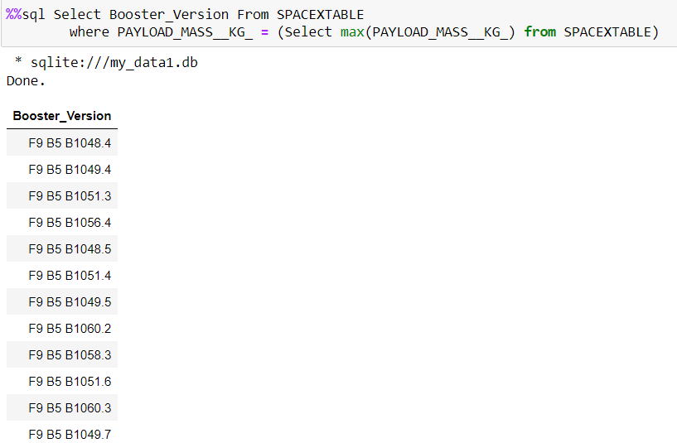
Boosters Carried Maximum Payload
Booster versions which carried the maximum payload mass

Slide 26
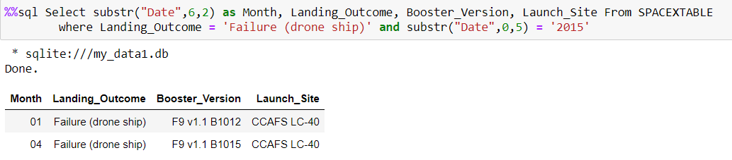
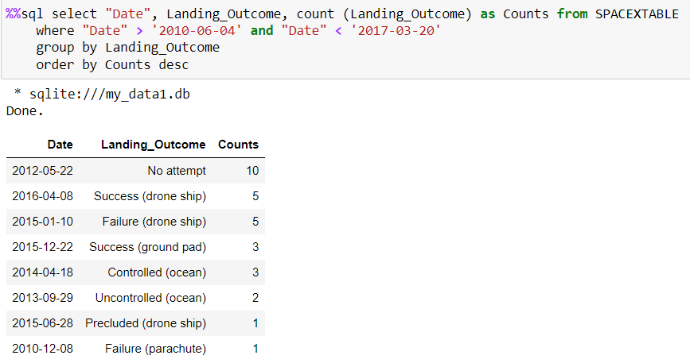
2015 Launch Records
Show the failure drone ship landing in 2015.
Rank and counting of each landing occurrence between the date 2010-06-04 and 2017-03-20

Slide 27

Section 3

Slide 28
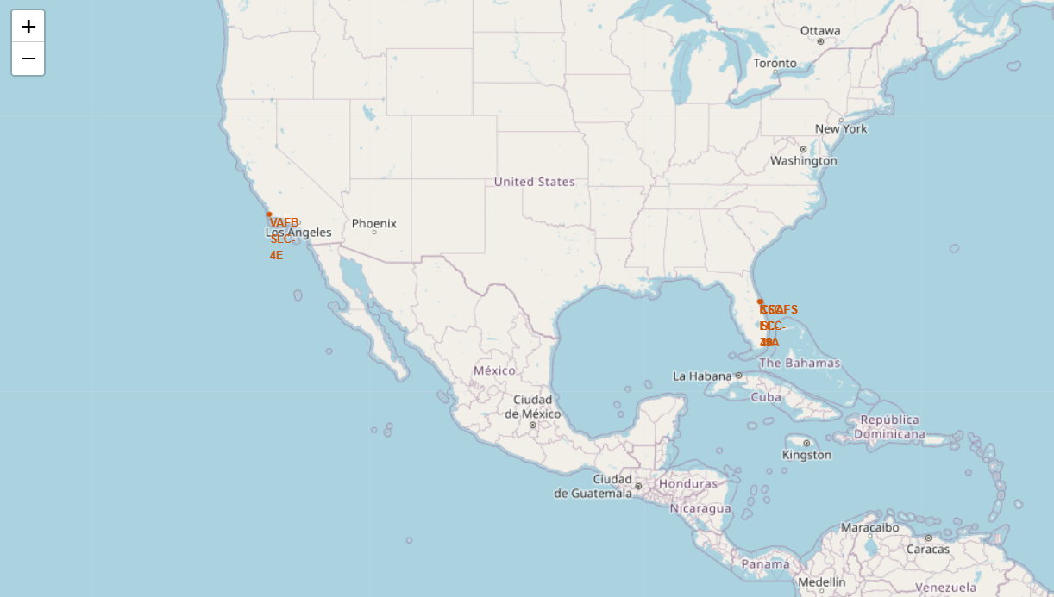
Launch Sites
California and Florida are the only states where there are launches
The main places is Florida

Slide 29
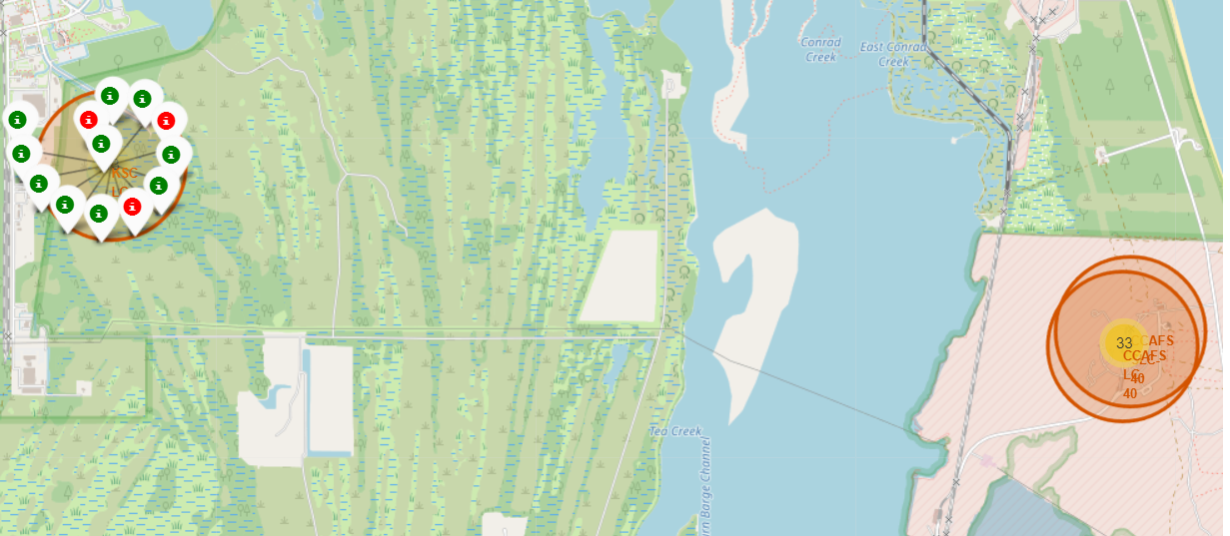
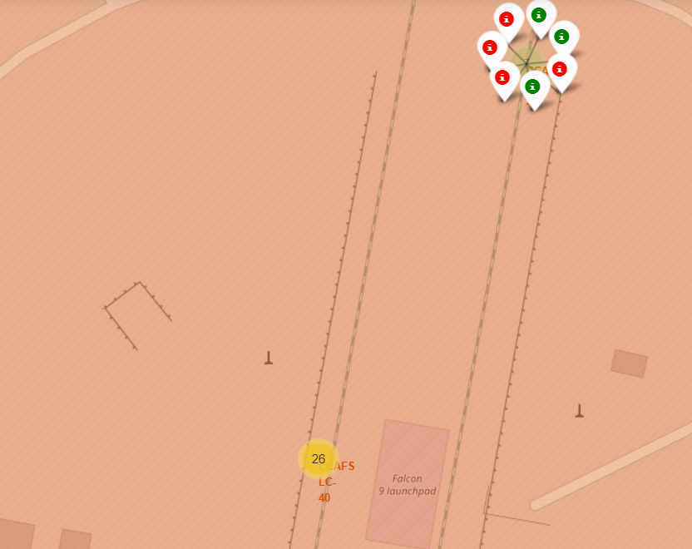
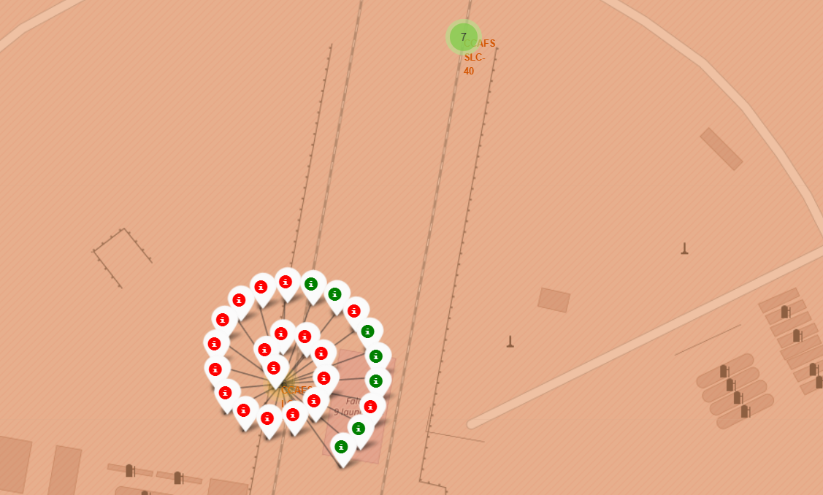
Launches sites markers
The markers helps to notices the number of launches and their outcomes.
KSC LC 39A has the best ratio of successful landing
CCAFS SLC-40 has the worst performance on successful landings.

Slide 30
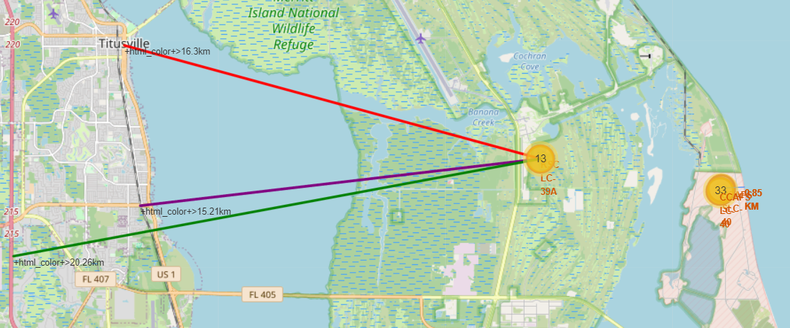
Distances to key points
The locations procures have coastlines near to them.
The locations procures to be far from cities due to any possible complication during launching.

Slide 31

Section 4

Slide 32
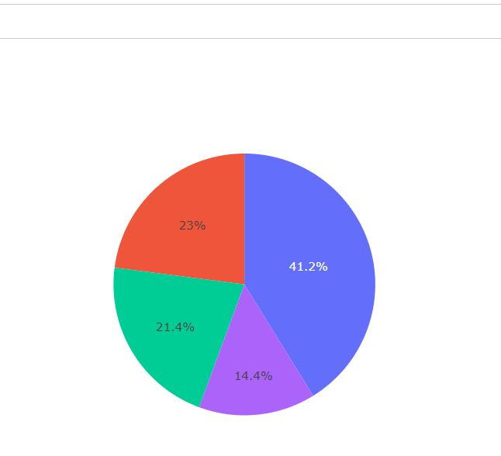

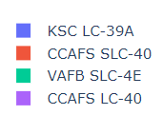
Proportion between launch site success
From all launch sites, KSC LC-39A has the best performance
On the other hand, CCAFS LC-40 has the lowest successful landing rate.

Slide 33
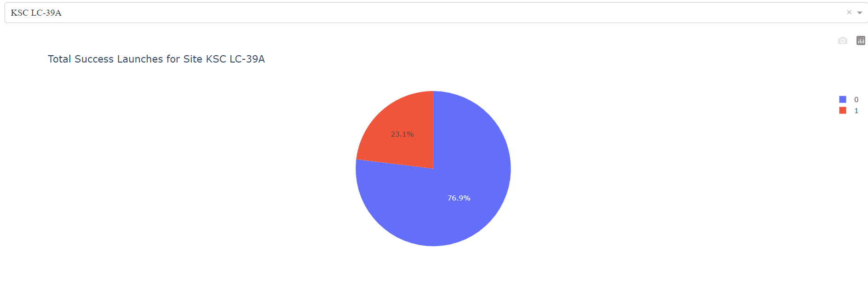
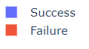
KSC LC-39A Successful landing
KSC LC 39A has the highest successful landing rate amongst launch sites (76.9%) consisted in:
10 successful landings
3 failure landings

Slide 34
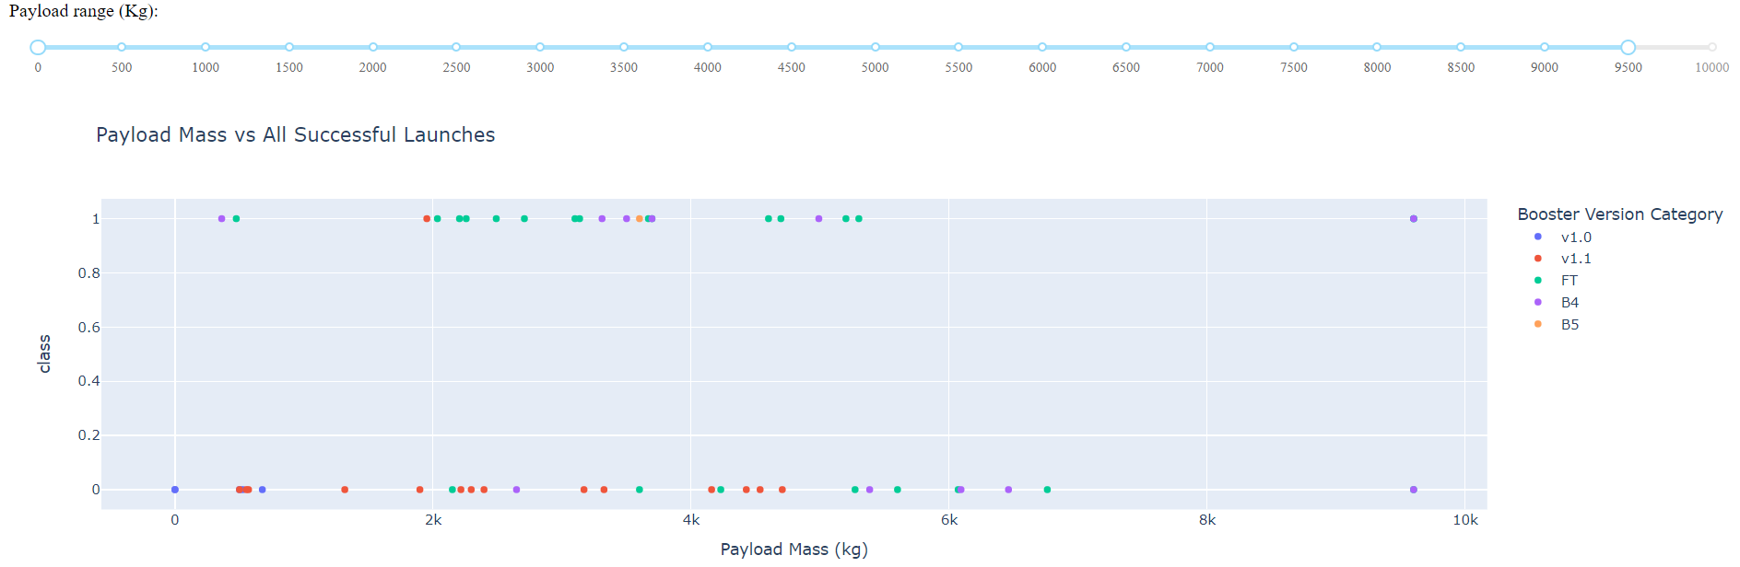
Outcome landing according payload mass
The payload range where the successful landing rate is higher is between 1950 kg and 5300 kg
The booster version FT has the best successful landing rate.

Slide 35

Section 5

Slide 36
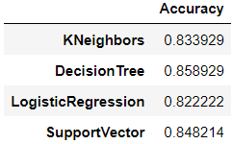
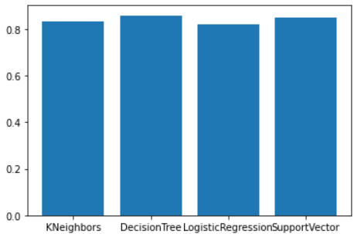
Classification Accuracy
All models present similar accuracy levels. However, the Decision Tree has the best performance between all models.

Slide 37
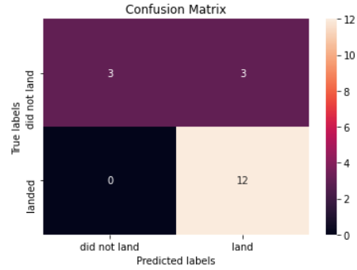
Confusion Matrix
The confusion matrix shows that the model can predict when the flight will land successfully.
However, the model produce some false positive results.
Even with this error type I, the model shows a good performance.

Slide 38
Conclusions
Even when SpaceX starts with some troubles to recover the first stage, as the flights were increasing, the performance and successful landing rate were improving.
The orbits SSO and VLEO shows the best performance to landing. On the other hand, and even its low successful landing rate in its first flights, after flight number 20 shows a good performance. Other orbits has successful landing rate; however, they have few flights to determine a realistic performance
The launching sites are chosen due to proximity to coastlines and being far from cities due to precautionary measure.
The Decision Tree is the best prediction model. Although all model shows a good performance

Slide 39


